Slide 1
Introduction to Hydro Informatics
Session 12

Slide 2
Model
A model can be defined as a simplified representation of reality with an objective of its explanation or prediction.
In engineering, the term model is used traditionally in one of two senses:
(a) a mathematical model based on the description of behavior (often physics, or first-order principles) of a phenomenon or system under study, referred later as behavioral (also process, or physically-based) models;
(b) a model built of material components or objects, which is often referred as scale (or physical) model (since it is usually smaller than the real system).

Slide 3
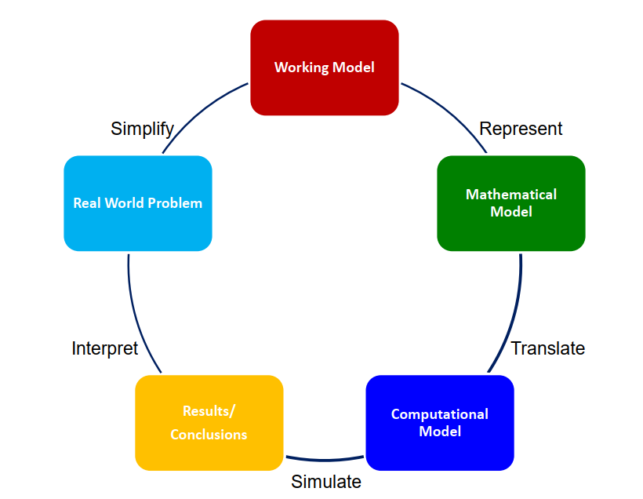
Mathematical Modelling Process

Slide 4
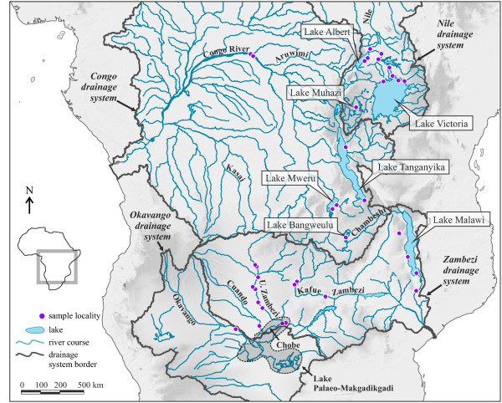
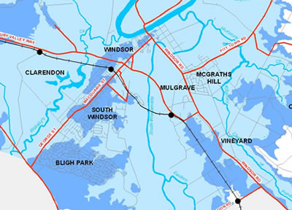
Classification of Models
Descriptive model vs Prescriptive Model
A descriptive model describes the existing conditions.
If we use maps as analogies, a natural drainage map would represent a descriptive model.
A prescriptive model offers a prediction of what the conditions could be or should be.
A 100 year flood map would predicts the areas that would be inundated.

Slide 5
Classification of Models
Stochastic model vs Deterministic Model
A stochastic model considers the presence of some randomness in one or more of its parameters or variables and hence follow some probability distributions.
As a result of random processes, the predictions of a stochastic model can have measures of errors or uncertainties, typically expressed in probabilistic terms.
This is why a stochastic model is also called a probabilistic or statistical model.
Eg: Kriging interpolation method
A deterministic model assumes variables to have unique values.
Eg: IDW (Inverse Distance Weighted) Interpolation

Slide 6
Classification of Models
Dynamic model vs Static Model
A dynamic model emphasizes the changes of a phenomena and the interactions between variables over time.
Eg: Soil moisture variation with time
A static model deals with the state of a phenomena at a given time. Eg: Impervious cover at a time.

Slide 7
Classification of Models
Deductive model vs Inductive Model
A deductive model represents the conclusion derived from a set of premises.
These premises are often based on scientific theories or physical laws.
An inductive model represents the conclusion derived from empirical data and observations.

Slide 8
Model Calibration
Calibration is the activity of verifying that a model of a given problem in a specified domain correctly describes the phenomena that takes place in that domain.
During model calibration, values of various relevant coefficients are adjusted in order to minimize the differences between model predictions and actual observed measurements in the field.
Verification is performed to ensure that the model does what it is intended to do.

Slide 9
Model Validation
Validation is performed using some other dataset (that has not been used as dataset for calibration).
It is the task of demonstrating that the model is a reasonable representation of the actual system so that it reproduces system behavior with enough fidelity to satisfy analysis objectives.

Slide 10
Sensitivity Analysis
Sensitivity is the rate of change in one factor with respect to change in another factor.
A modeling tool that can provide a better understanding of the relation between the model and the physical processes being modeled.

Slide 11
Data Driven Modelling
Data-driven modelling is an approach to modelling that focuses on using the Computational Intelligence (particularly Machine Learning) methods in building models that would complement or replace the “knowledge-driven” models describing physical behavior.
Data driven modelling requires sufficiently large amount of data to train the model and also test data in order to test the model.

Slide 12
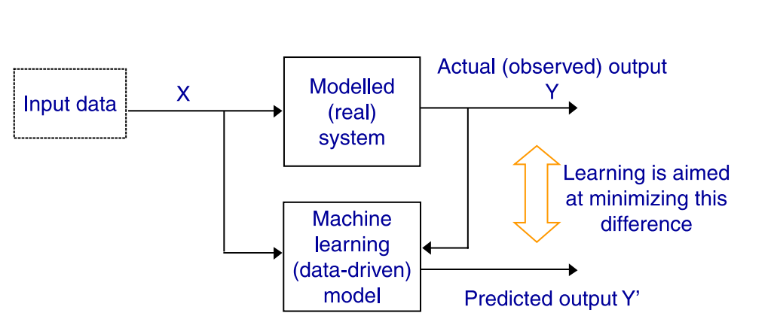
Data Driven Modelling

Slide 13
Popular methods in Data Driven Modelling
Multilayer perceptron (MLP)
Radial basis functions (RBF)
Genetic programming (GP) and evolutionary regression
Support vector machines (SVM)
Chaos theory and nonlinear dynamics
Instance-based learning (IBL)

